Slide 1

Virtual Employee
April 9, 2025

Slide 2
What is the Virtual Employee?
The Virtual Employee (VE) began as an ambitious concept: an AI assistant capable of seeing the user’s screen, interpreting on-screen instructions (originally envisioned to be pulled from BA Insight), and performing tasks using the keyboard and mouse on behalf of the user.

Slide 3
Early Concept & First Lessons
The initial proof of concept was extremely limited—not even an alpha version—but it demonstrated a critical breakthrough: it’s possible for an AI to visually interpret a user’s screen, make decisions based on that input, and control the computer like a human would.
At that stage, we were not aware of any other company doing anything similar.

Slide 4
Building Functionality: Software Installs
The next milestone was getting the VE to perform basic software installations. While it worked, it was slow and less capable than a skilled human, especially when things got complicated.
Writing instructions for the VE was a trial-and-error process. Although the instructions use natural English language, crafting them effectively required experience and iteration.
Lesson learned: The VE could do useful work, but not faster or better than a human with expertise in that area. Additionally, writing instructions was a non-trivial part of the process.
Around this time, we started seeing reports that Microsoft was working on a similar project.

Slide 5
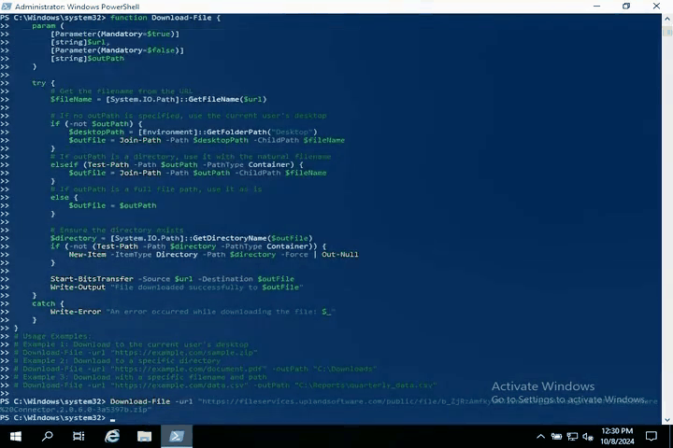
Demo of VE Doing Software Install

Slide 6
A Big Idea: Learning from Video
Real-World Challenge: Altify
Market Validation: Anthropic’s Demo
Sean Coleman proposed a major leap: what if the VE could write its own instructions by watching training videos? This would eliminate one of the biggest barriers—manual instruction writing.
At first, we didn’t know how to achieve this, but believed it was possible.
We tried applying the VE to Altify, a CRM-ish tool where building contact trees is a time-consuming human task. Unfortunately, this proved extremely difficult for the VE. Understanding human relationships—core to Altify’s functionality—was outside the VE’s capabilities and likely always will be.
At this point, Anthropic unexpectedly released a “computer use” demo. It had all of the same weaknesses that our VE had—plus a few more—but marked the first major move by a large software company in this direction. It was a strong signal that our vision had broader industry traction.

Slide 7
Telecom Portals: The CIMPL Use Case
CIMPL presented a compelling use case. CIMPL’s admins need to interact with telecom provider portals, many of which lack APIs, on a daily basis.
The VE could handle these interactions, but faced new challenges:
  No sandbox environments exist for telecom portals, making trial-and-error risky
  Carl created mock portals using rapid AI prototyping to safely train the VE, which worked but was labor-intensive
  Telecom portal workflows involved long sequences of steps. The longer the sequence, the higher the chance of VE making an error. This problem will likely diminish as AI reliability improves—and there are ways we could overcome this now—but long sequences of dependent steps remain a challenge for the VE
By this point, Google, Microsoft, and OpenAI had all begun developing their own VE-like systems. We saw this as validation: AI agents that can operate computers directly for users are clearly inevitable.

Slide 8
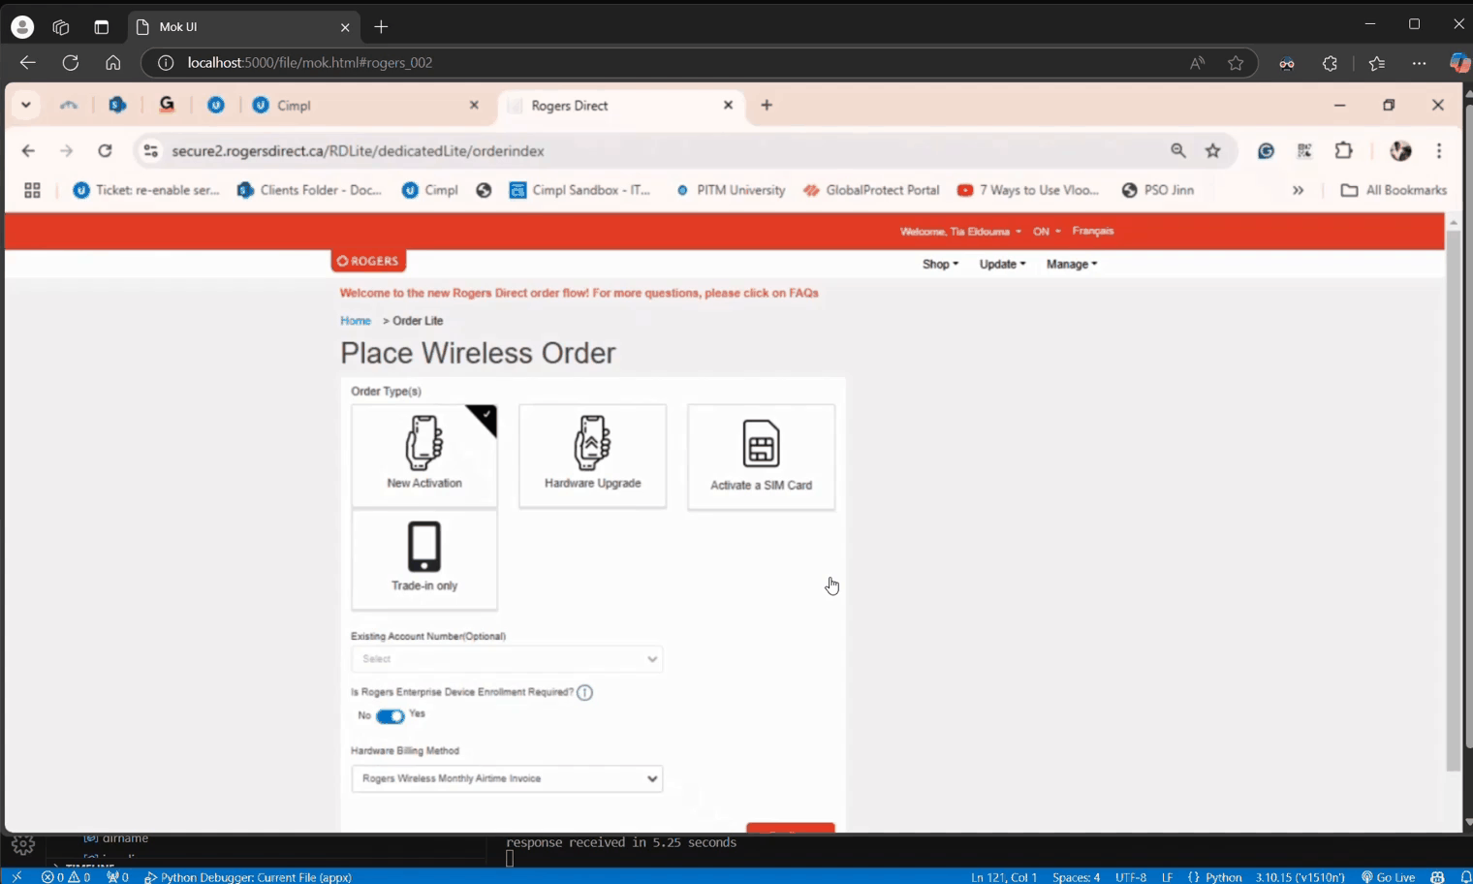
Demo of VE Doing Operating a Telecom Portal

Slide 9
A Strong Fit: Panviva Ingestion
We ran a two-week sprint to test the VE with Panviva, whose new customers must import training materials—PDFs, Word docs, PowerPoints, and videos—into the platform. This repetitive 10–20 step process was ideal for the VE.
  Critically, the VE could read and understand content across formats, including video.
Key insights gained:
  Since the VE can understand the content it works with, not just blindly convert one set of bytes to another, new possibilities emerge: e.g., “Ignore the poor organization and formatting of these documents, but enter them into Panviva in an organized and principled way.”
  The VE’s ability to operate both APIs and UIs enables it to perform tasks that humans cannot.
  Thanks to this project giving Carl hands-on experience with video content, he successfully enabled the VE to:
    Watch a training video
    Generate its own set of instructions
    Execute those instructions autonomously
    It wasn’t perfect, but it worked.
Shortly after, Amazon announced “Nova”—its own computer-operating agent, also attempting to learn from training videos. Another validation of the direction we were headed.

Slide 10
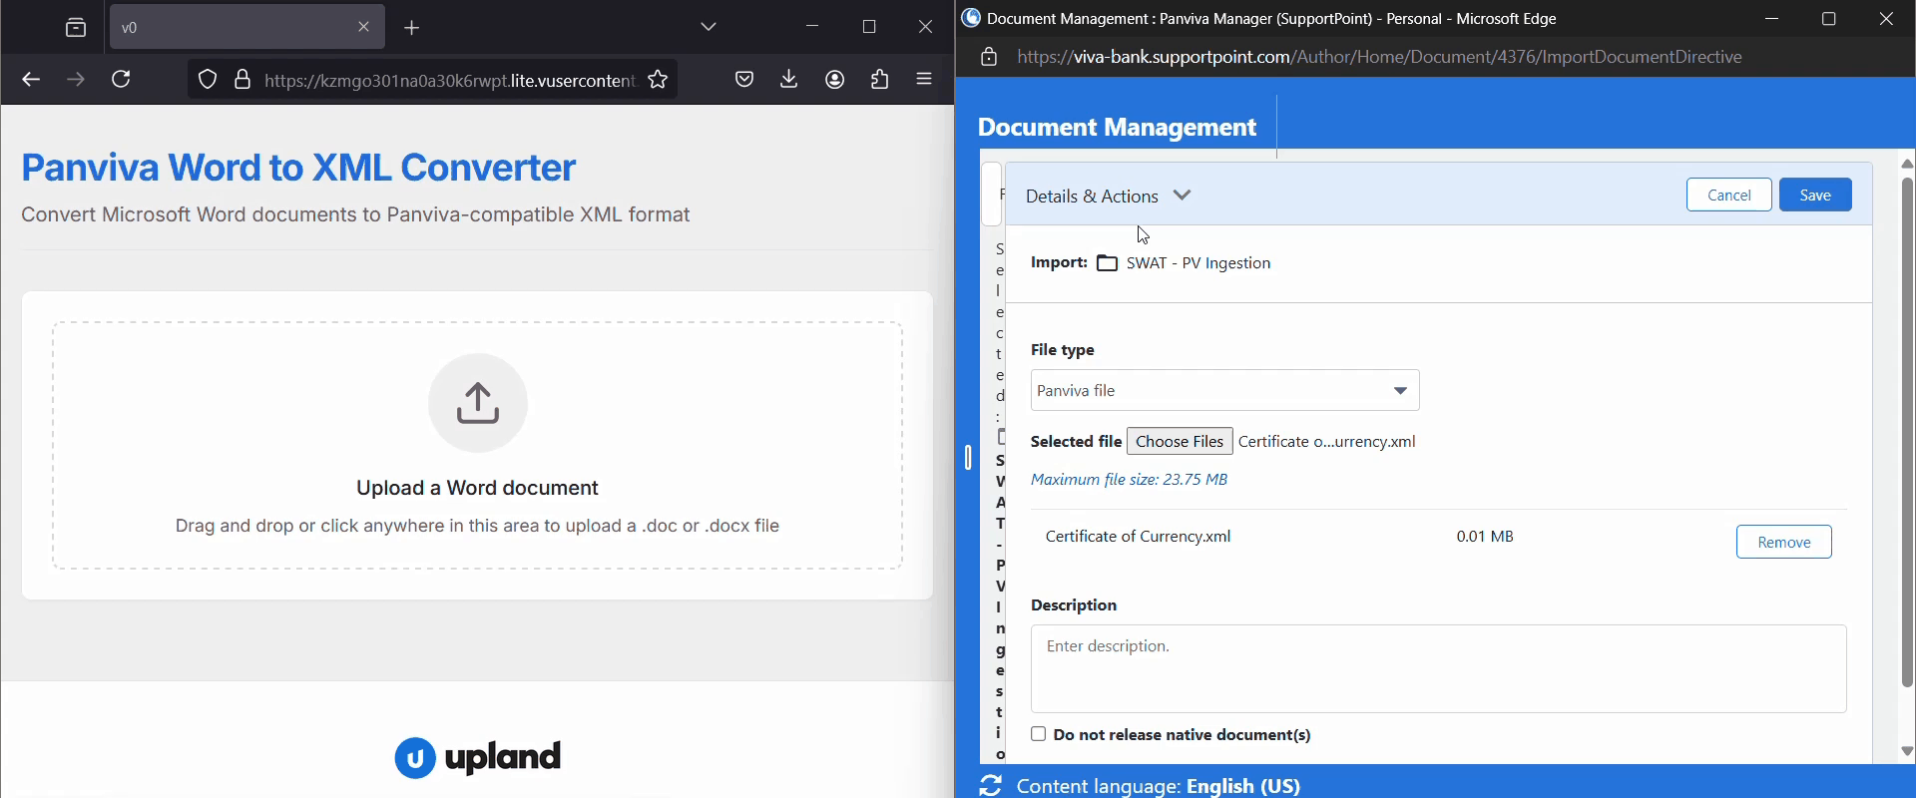
Demo of VE Importing Content into Panviva

Slide 11
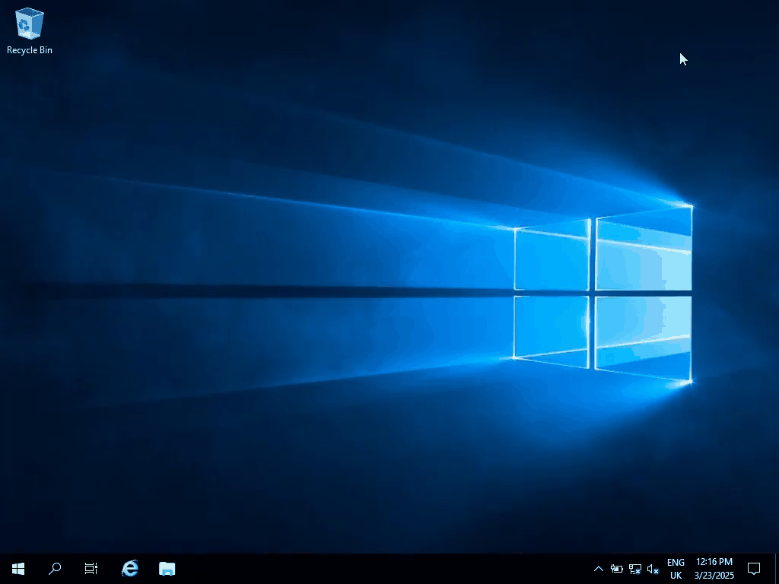

And Now, VE Can Learn From Video!
VE doing the same thing on Windows 2011
Training video recorded
by a human on
Windows Server 2019

Slide 12
What’s Next for the Virtual Employee?
Several potential paths lie ahead for the VE:
Integrated BA Insight Assistant
The VE becomes a seamless extension of BA Insight. When users search for information or instructions through BA Insight, the VE can not only find the relevant information but also offer to execute those instructions directly, bridging the gap between finding knowledge and implementing it.
BA Insight-Powered Information Retrieval
The VE leverages BA Insight’s powerful search capabilities to access internal documents, knowledge bases, and resources. Rather than users having to click through multiple links to get answers to their questions, the VE can quickly and invisibly use BA Insight APIs to search, then present comprehensive answers to users’ questions, along with links to source materials.
Plug-In for Upland Products
We teach the VE how to use any Upland software product, thereby giving that product AI-agent capabilities.
Tool for System Administrators
System admins managing thousands of virtual machines (VMs) often rely on APIs—but that last 1% of tasks can be painful. With just a couple of training videos, the VE could replicate those manual steps across hundreds or thousands of VMs.

Slide 13
Upland’s Competitive Advantage!
While large AI companies focus on general-purpose agents using public internet data, the VE (especially when integrated with Upland products) has a distinct advantage: access to customer-specific data, policies, and procedures. Information like how to open an internal trouble ticket or follow a company-specific workflow is not available online, and never will be. An AI agent securely connected to this internal knowledge ecosystem can provide assistance that generic agents cannot, creating valuable, defensible use cases for ai agents.
You Tell Us
The future of the VE is still unfolding. Its flexibility and evolving intelligence open up a range of possibilities limited only by imagination.

